Slide 1

Med-Help
An app that allows you to check what over the counter medicine does, side effects, dosage, and compatibility with other medicines and illnesses you may have

Slide 2
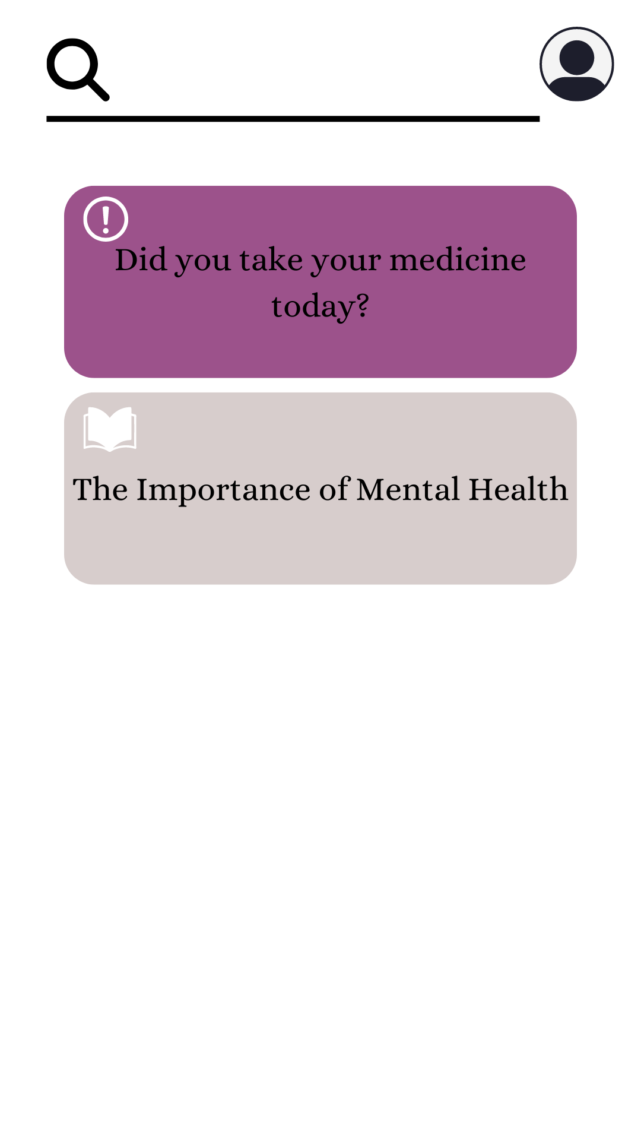
The Home Page
A personal reminder
Based on your profile, it will show the medicine you suppose to take, and the things you have already taken during this day or what you haven’t.
A page for information about mental health
Let people be aware of mental health.

Slide 3
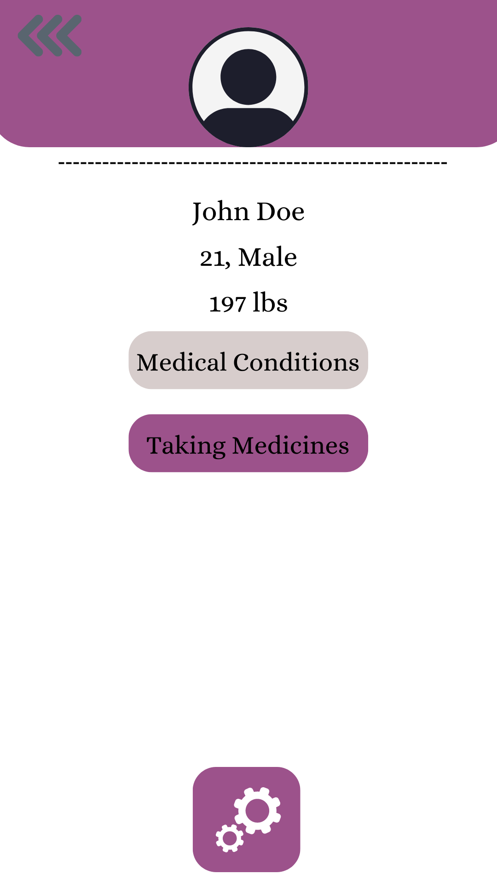
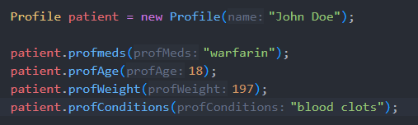
Profile
Example of A profile for John doe being created where the medicines he is taking is warfarin and his current medical condition(s) is blood clots
Notes:
Profile page
displays the user’s age, sex, weight, and name so that the app can correctly give the right amount of dosage.
Medical conditions - shows what medical conditions the user currently has
Taking medicines - shows which medicines the user is currently taking

Slide 4
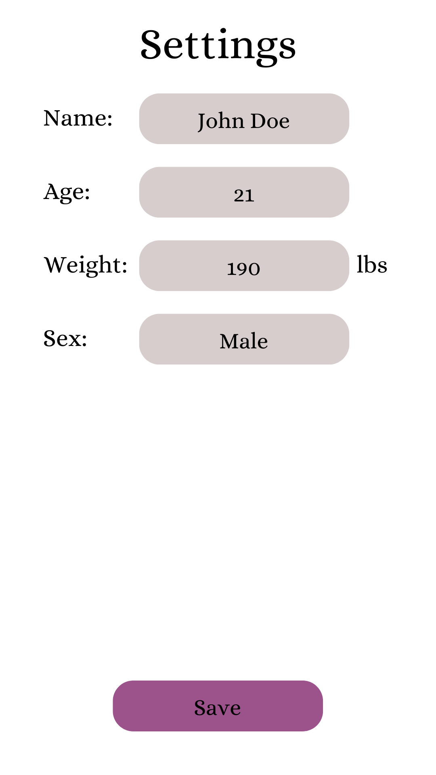
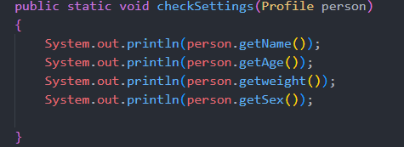
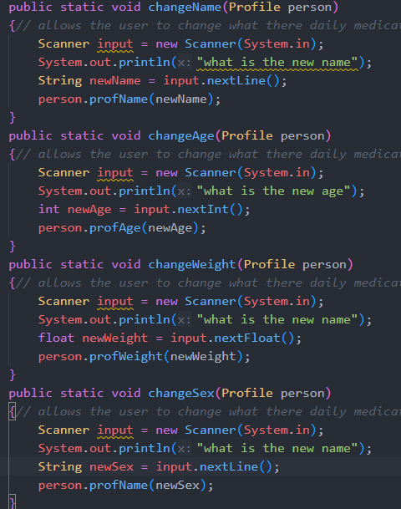
Checking Settings
Notes:
The cog wheel takes you to the settings page
Can edit essential user information

Slide 5
Profile
Notes:
After saving, tap the Taking Medicines

Slide 6
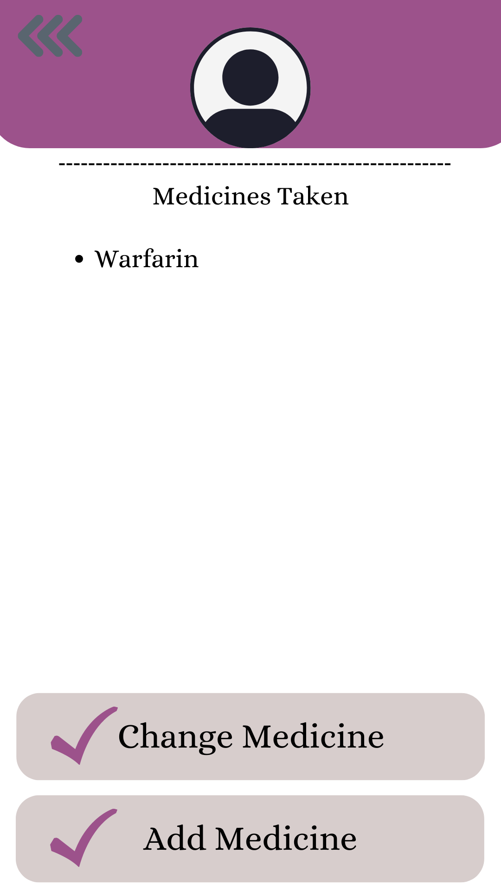

Medicines Taken
Notes:
Displays currently taking medicines and also allows the user to edit the medicines they’re taking or add another

Slide 7
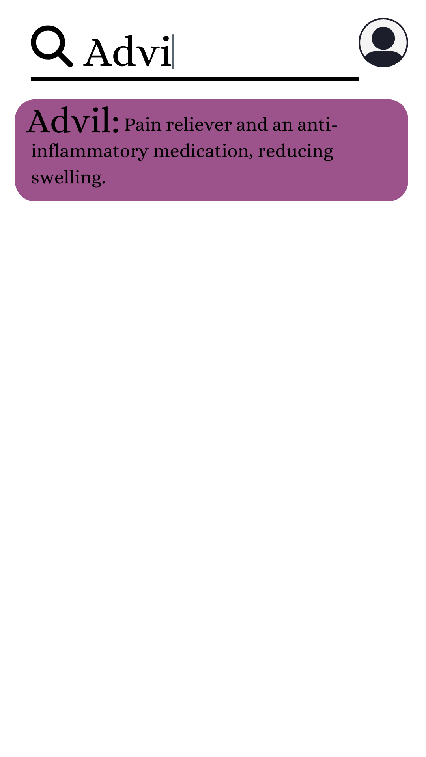
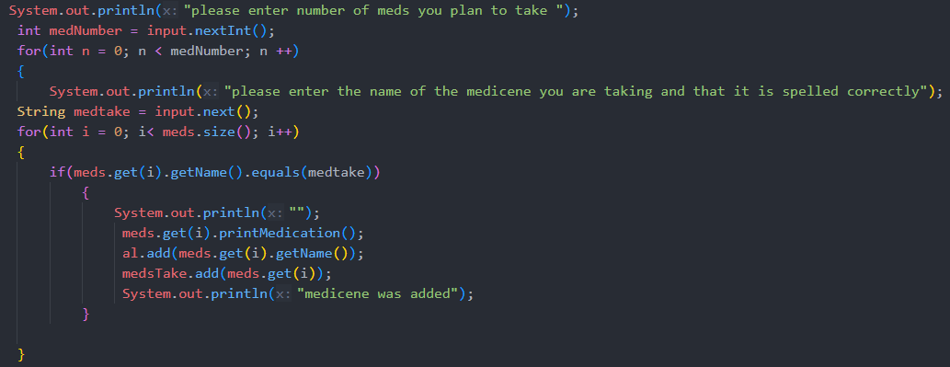
Taking New Medicine
Notes:
If you add another, they would go to a search bar where they would be able to search for their medicine
A drop down list will appear suggesting and trying to guess what medicine you’re trying to add
Along with a small description of the medicine

Slide 8
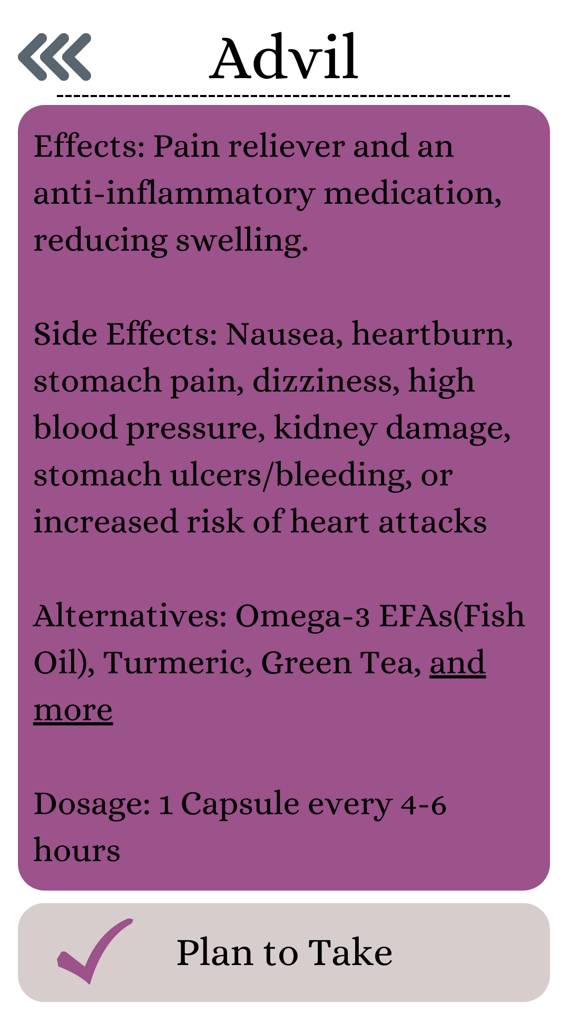
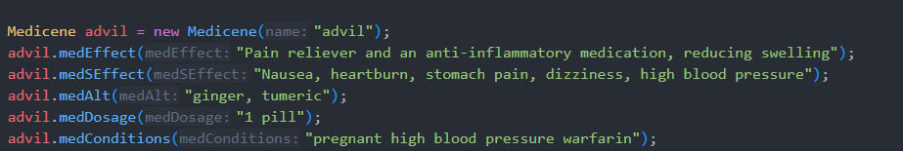
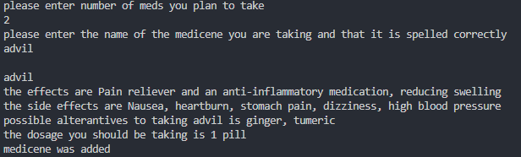
Taking New Medicine
Advil is in our database as well as has all of it attributes
Notes:
When tapping on the chosen medicine it gives a more detailed description before letting you add it to your list of medicines

Slide 9
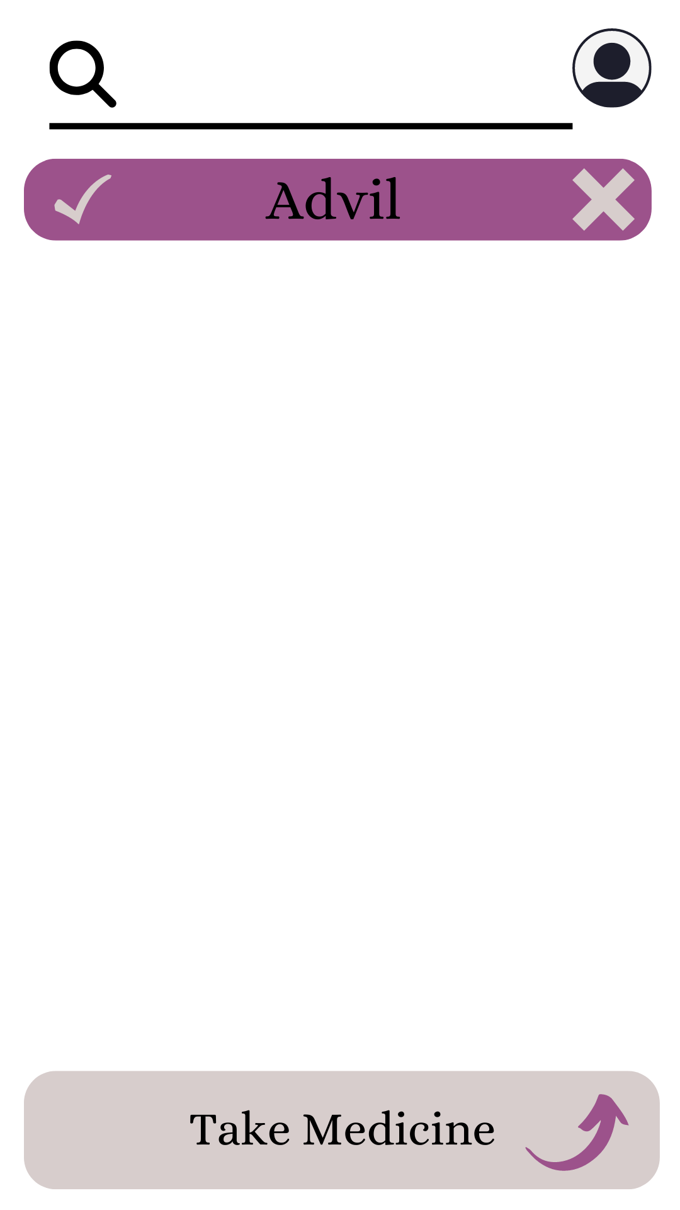
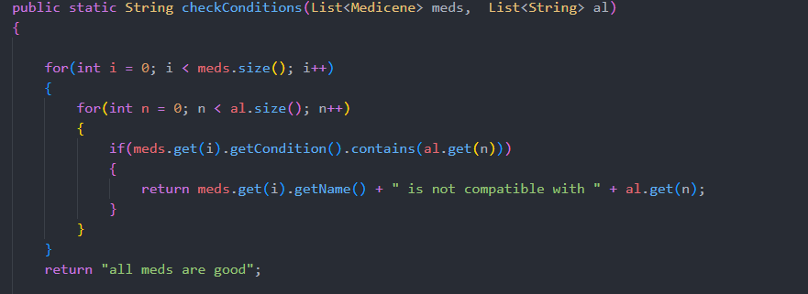
Taking New Medicine
Notes:
Once you do, you get an opportunity to add more medicines or remove medicines before choosing take medicine
When you click on the take medicine button, the app will calculate and see if your new medicine is compatible with the other medicines you’re taking or if you can take the medicine with the conditions you have listed in your profile

Slide 10
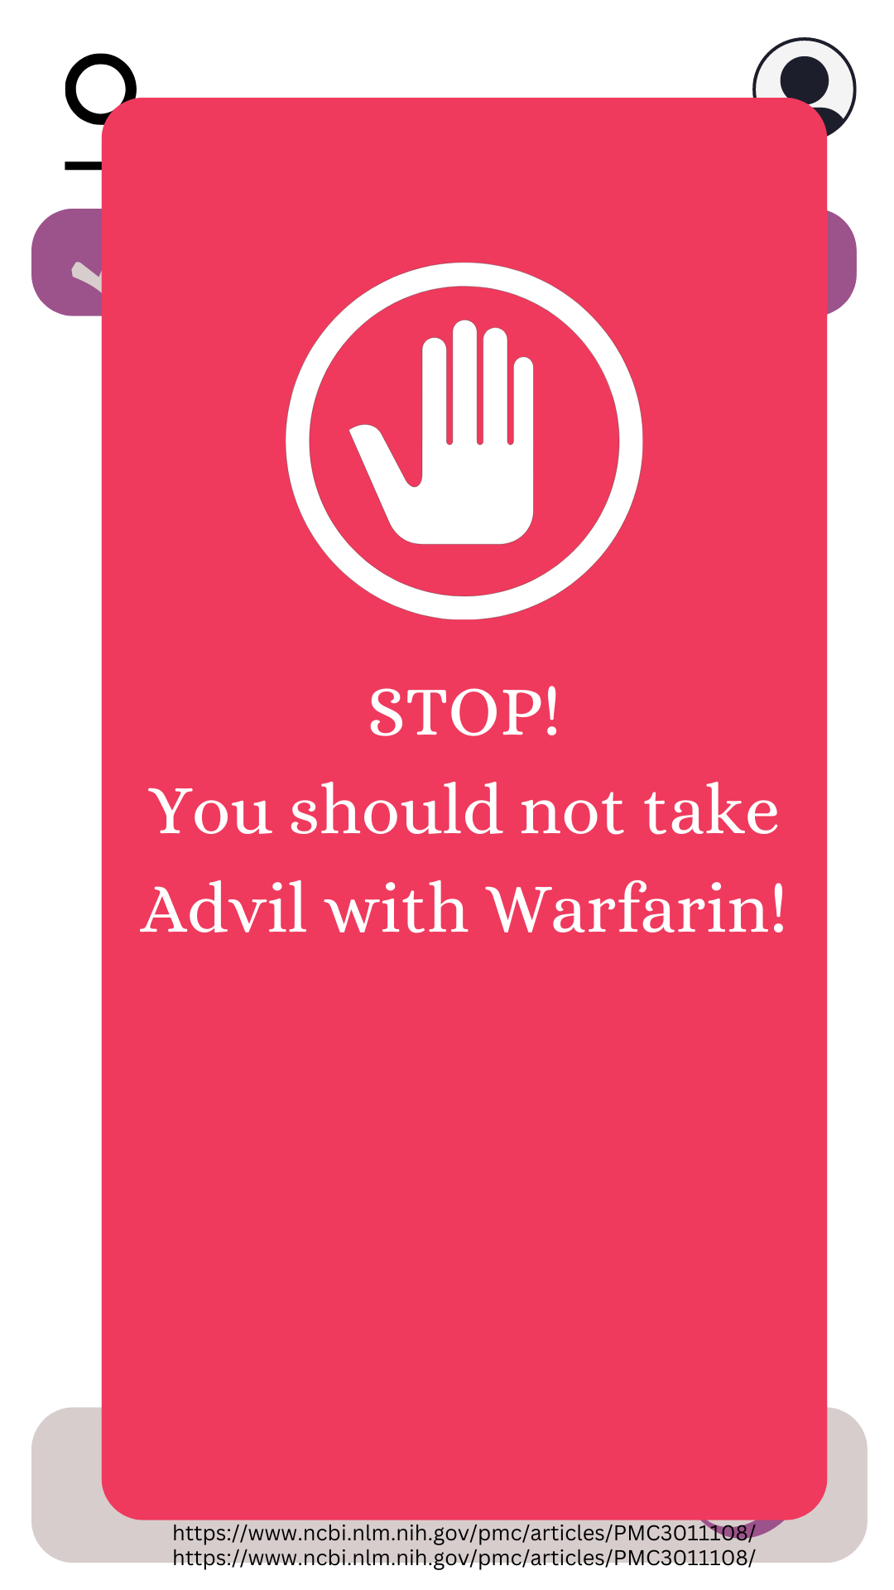
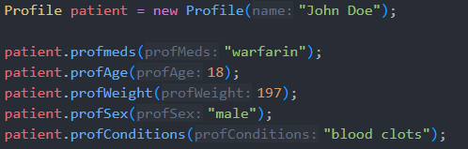
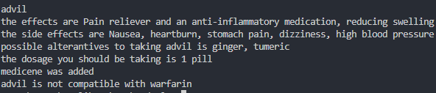
Uhoh!
Notes:
Uhoh! Since the advil failed the compatibility test, the app sends an error and doesn’t let you add the new medication
Let’s say John wasn’t taking warfarin

Slide 11
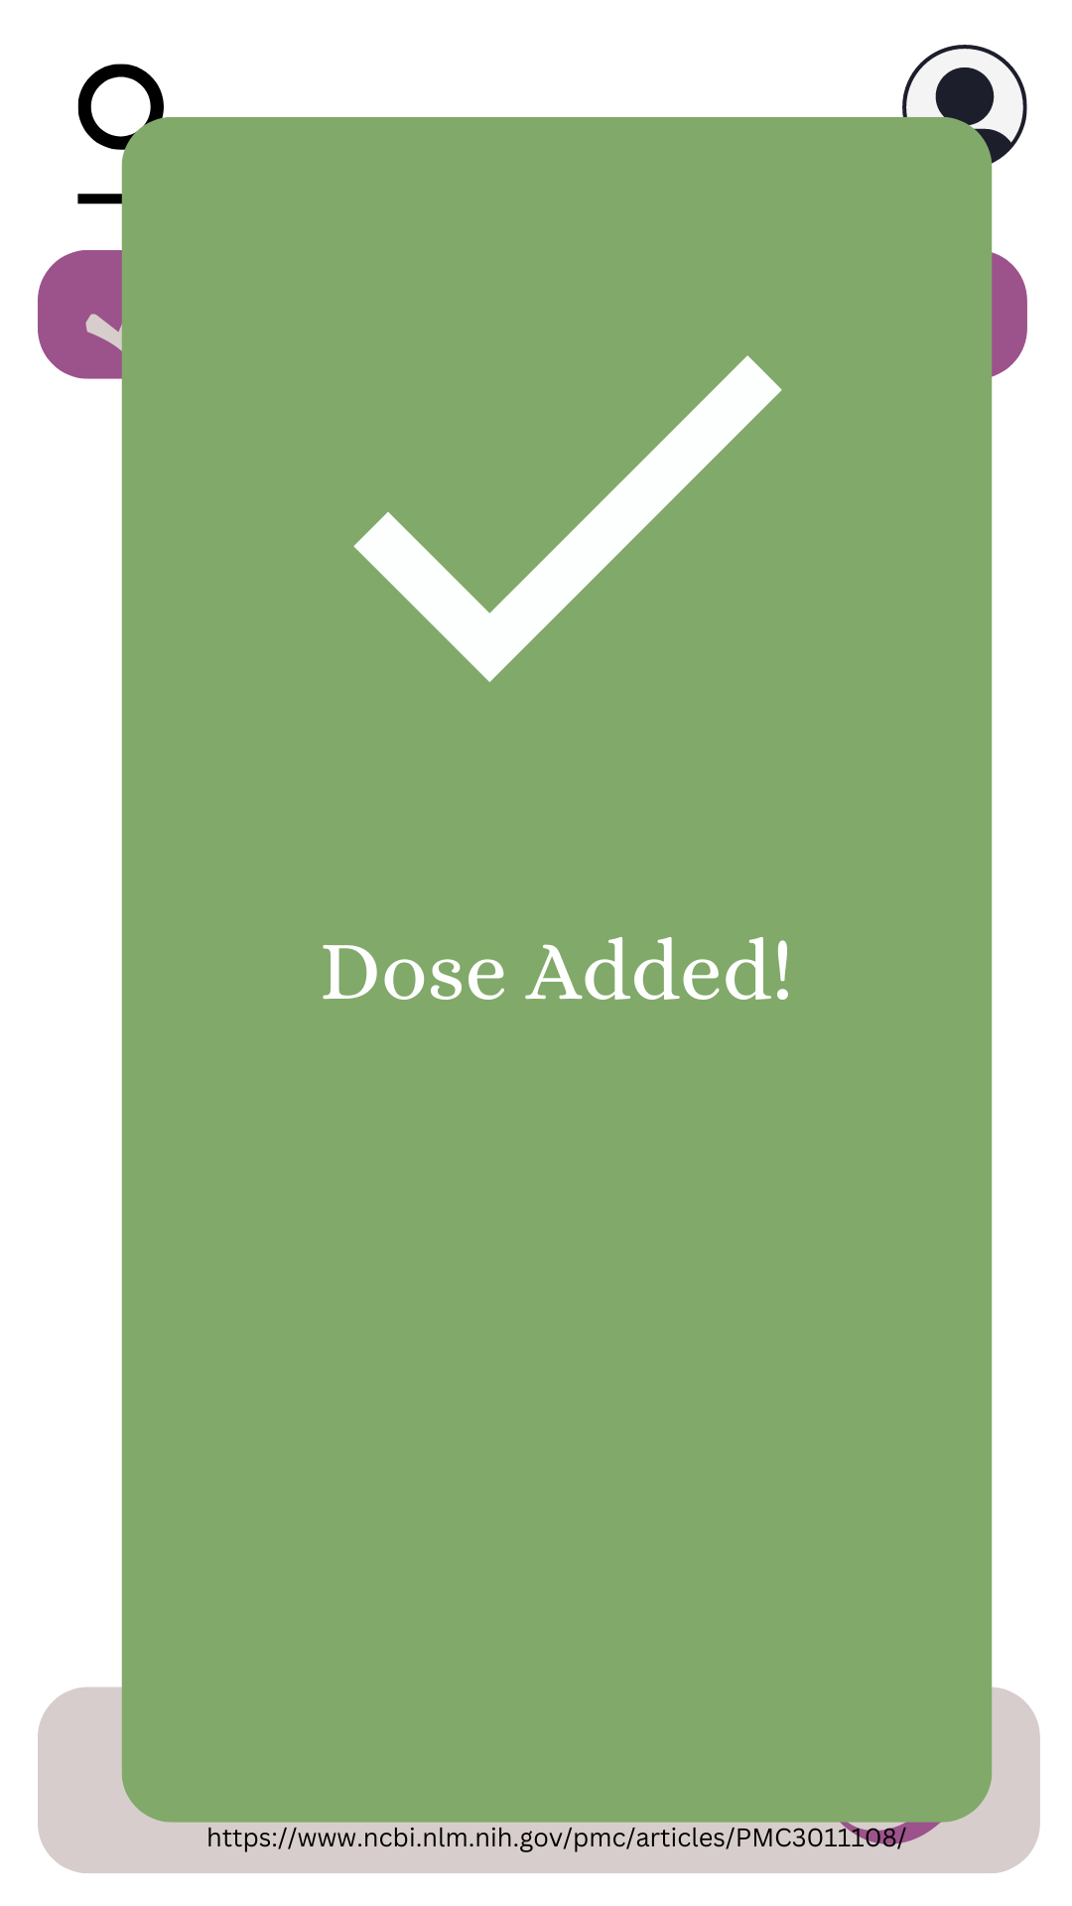
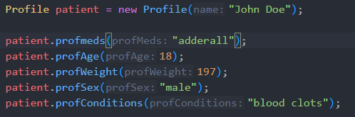
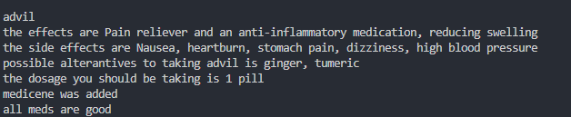
What if John didn’t take Warfarin?
Notes:
There’s no incompatibilities and the new medicine is added

Slide 12
The Home Page
Notes:
After the dosage is added, you are taken back to the home page

Slide 13
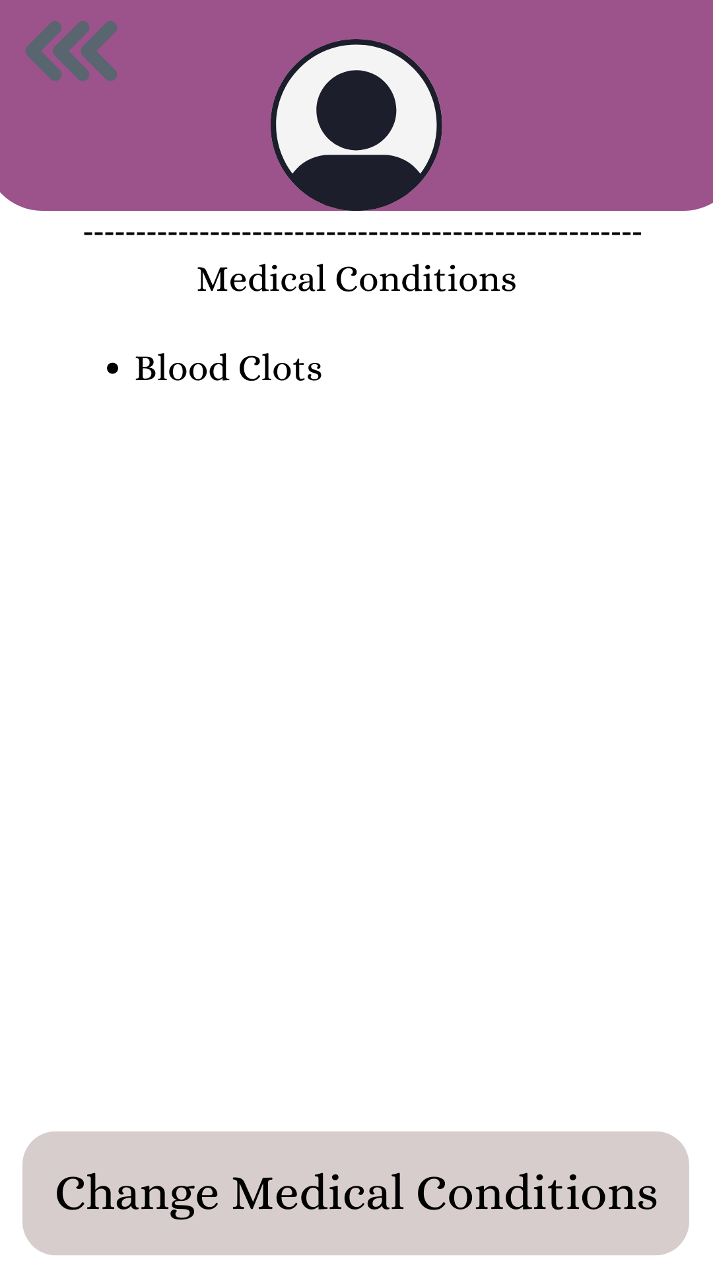

Check Medical Conditions through Profile
Notes:
If you were to navigate to the medical conditions tab in your profile, it lets you change your medical conditions

Slide 14
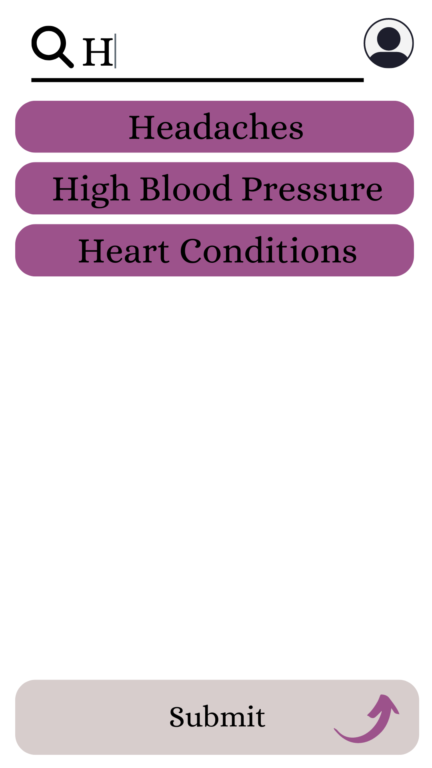
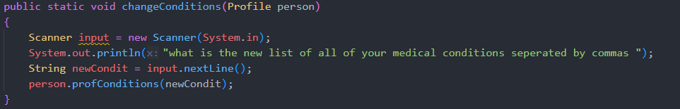
Changing Your Medical Conditions
Notes:
A similar drop down list will appear letting you choose the condition you want to add. Adding it will be similar to adding new medication

Slide 15
Thank you for listening!
Thank you to Gloria, Priyanka, and Ishita for helping with medical research!

